Slide 1

Database basics | SQL

Slide 2
What is a Database (DB)?
Any collection of related information
Shopping list
Todo list
Facebook‘s user base
Phone book
Database can be stored in different ways
On a computer
On paper
In your mind
This powerpoint

Slide 3
Computers / Paper
Amazon.com
Todo list
Products, reviews, purchase orders, credit cards, users
Trillions of information need to be stored
Information is valuable and critical to Amazon‘s functioning
Security is essential
Information stored on a computer
Simple list of things needs to be done
Couple of information need to be stored
For convenience sake not necessary for doing things
Security is not important
Information store on a piece of paper

Slide 4


Database Management Systems
Software for creating and maintaining a database
Importing/exporting data
Concurrency
Handles security
Easy to manage large amounts of data
Tato fotka od autora Neznámý autor s licencí CC BY-SA

Slide 5
Two types of DBs
Relational Databases (SQL)
Data in tables
Each table has columns and rows
A unique key identifies each row
Non-Relational (noSQL)
Organize data is anything but a table
Key-value stores
Graphs
Flexible tables

Slide 6
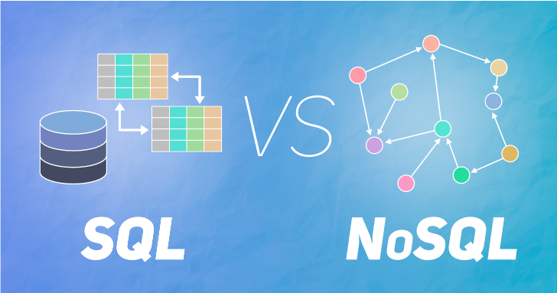

Slide 7
Relational databases (SQL)
Users table
Student table
*Username | Password | Email
jos313 | 1234 | …
taylorbest | … | …
catlov4 | … | …
lolofon | … | …
*ID | Name | Major
1 | Daria | Chemistry
2 | Terka | HR
3 | Radek | PM
4 | Standa | Software

Slide 8
Relational databases (SQL)
Relational Database Management Systems (RDBMS)
Software – Microsoft SQL, mySQL, Oracle, postgreSQL, etc.
Structured Query Language (SQL)
Standard language for RDBMS
CRUD operations (create, read, update, delete)
Definition of tables and structures

Slide 9
Wrap Up
Database is any collection of related information
Computers are great for storing dbs
Database management systems make it easy to create, maintain and secure a database
DBMS allow you to perform CRUD and other administrative tasks
Two types of Dbs, Relational & Non-relational
Relational – use SQL and store data in tables with rows and columns
Non-relational – store data using other data structures

Slide 10
Db example
Employee
Emp_id | First_name | Last_name | Birth_date | Sex | Salary
100 | Jan | Good | 1964-07-12 | M | 30000
101 | Petr | Bad | 1977-02-03 | M | 45000
102 | Jana | Beauty | 1969-04-08 | F | 50000
103 | Angela | Merkel | 1944-04-09 | F | 15000
104 | Andy | Nothere | 1973-07-22 | M | 65000

Slide 11
Db example
Employee
Emp_id | First_name | Last_name | Birth_date | Sex | Salary | Branch_id
100 | Jan | Good | 1964-07-12 | M | 30000 | 2
101 | Petr | Bad | 1977-02-03 | M | 45000 | 2
102 | Jana | Beauty | 1969-04-08 | F | 50000 | 3
103 | Angela | Merkel | 1944-04-09 | F | 15000 | 1
104 | Andy | Nothere | 1973-07-22 | M | 65000 | 1
Branch
Branch_id | Branch_name | Manager_id
1 | Prague | 104
2 | Brno | 100
3 | Pilsen | 102

Slide 12
Db example
Employee
Emp_id | First_name | Last_name | Birth_date | Sex | Salary | Branch_id
100 | Jan | Good | 1964-07-12 | M | 30000 | 2
101 | Petr | Bad | 1977-02-03 | M | 45000 | 2
102 | Jana | Beauty | 1969-04-08 | F | 50000 | 3
103 | Angela | Merkel | 1944-04-09 | F | 15000 | 1
104 | Andy | Nothere | 1973-07-22 | M | 65000 | 1
Branch
Client
Branch_id | Branch_name | Mgr_id
1 | Prague | 104
2 | Brno | 100
3 | Pilsen | 102
Client_id | Client_name | Branch_id
400 | PPL | 1
401 | Koito | 2
402 | CTU | 1

Slide 13
Employee
Emp_id | First_name | Last_name | Birth_date | Sex | Salary | Branch_id
100 | Jan | Good | 1964-07-12 | M | 30000 | 2
101 | Petr | Bad | 1977-02-03 | M | 45000 | 2
102 | Jana | Beauty | 1969-04-08 | F | 50000 | 3
103 | Angela | Merkel | 1944-04-09 | F | 15000 | 1
104 | Andy | Nothere | 1973-07-22 | M | 65000 | 1
Branch
Works_With
Branch_id | Branch_name | Mgr_id
1 | Prague | 104
2 | Brno | 100
3 | Pilsen | 102
Emp_id | Client_id | Total_sales
103 | 400 | 147000
101 | 400 | 57000
104 | 401 | 122000
102 | 402 | 170000
100 | 402 | 14000
103 | 401 | 36800
102 | 400 | 68000
Client
Client_id | Client_name | Branch_id
400 | PPL | 1
401 | Koito | 2
402 | CTU | 1

